Slide 2
Machine
Learning
Oliver Zhang and Joshua Zhu

Slide 3
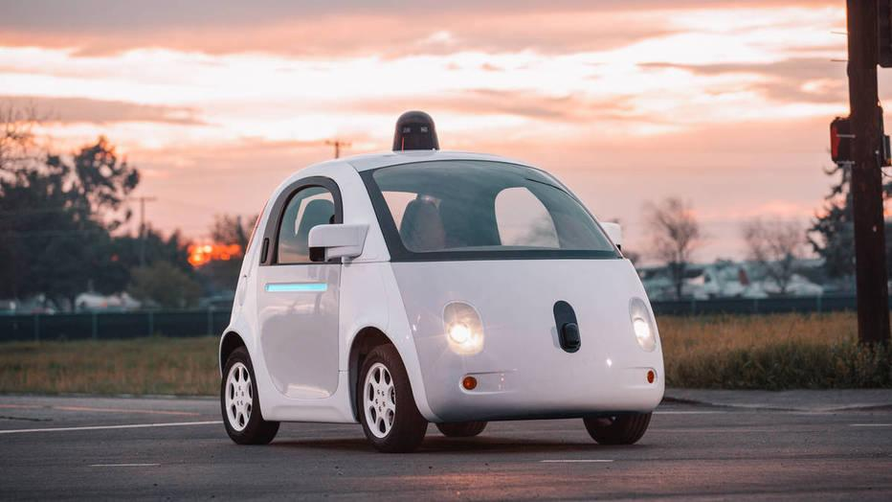

Slide 4
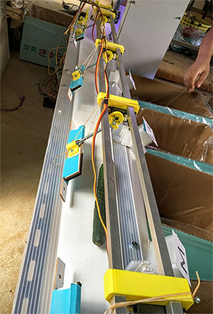

Slide 5
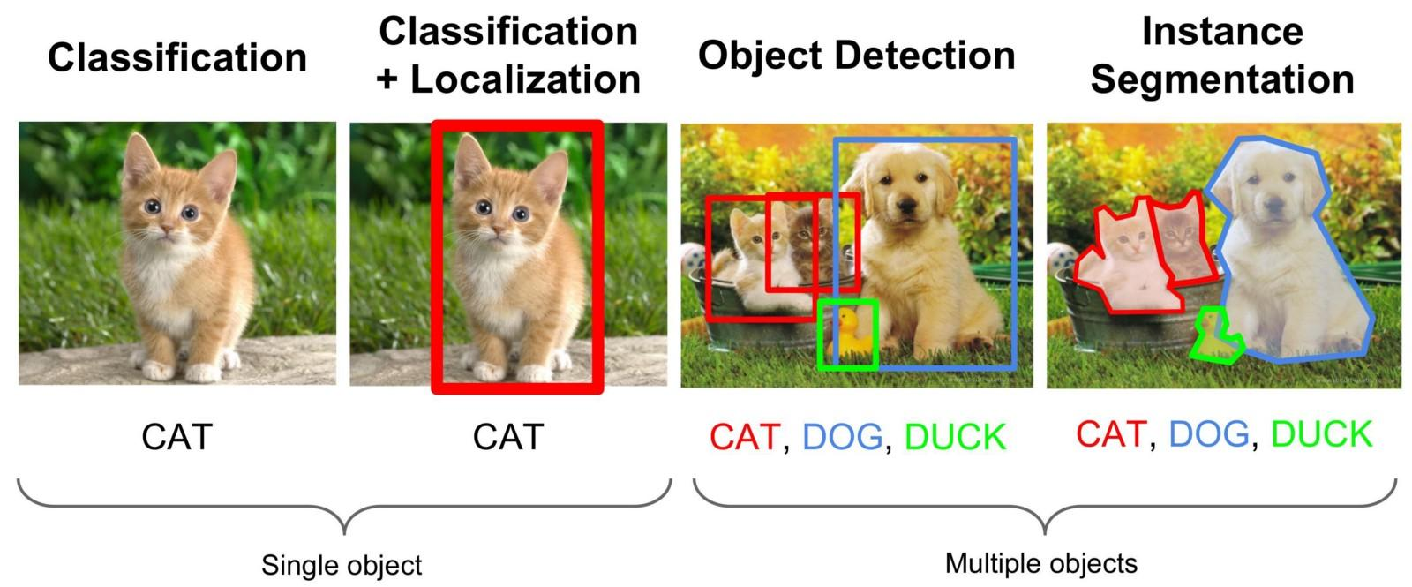

Slide 6
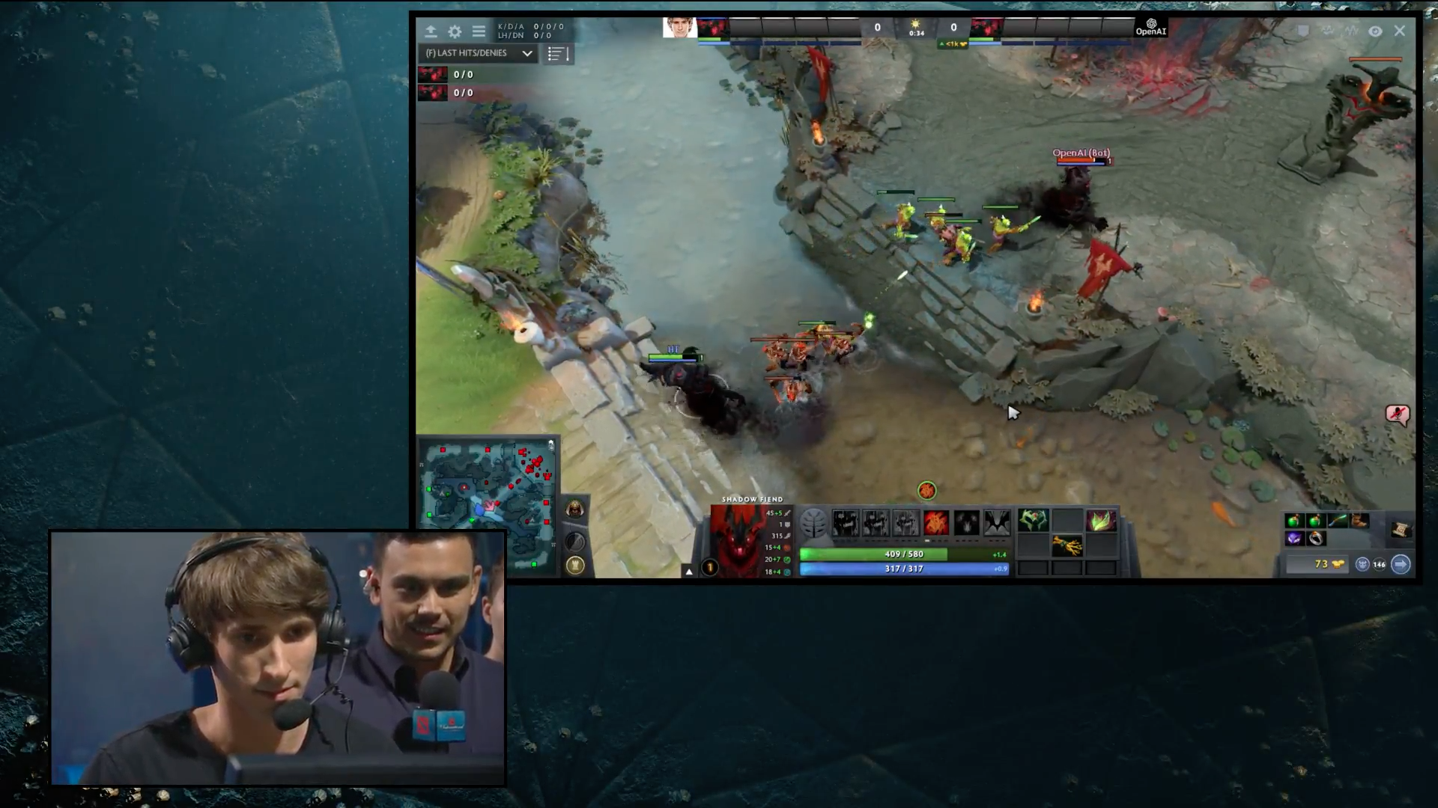

Slide 7
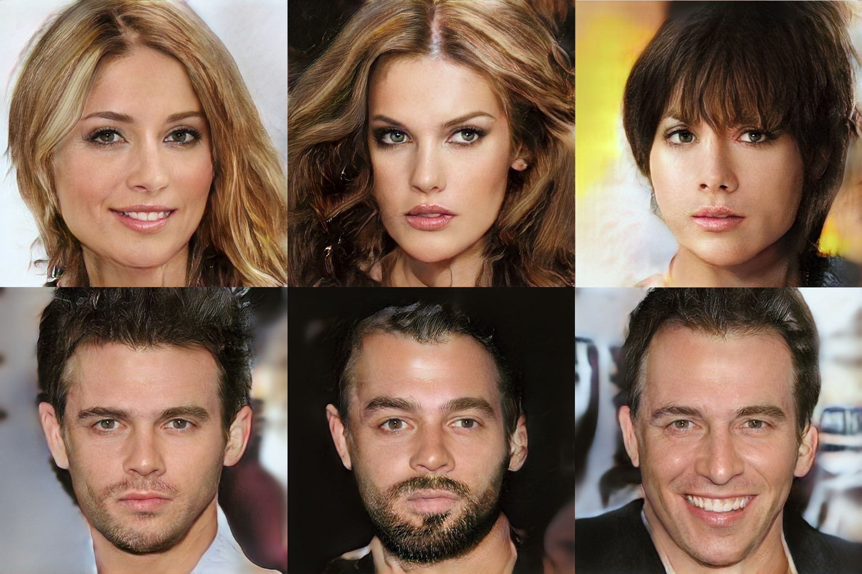

Slide 8
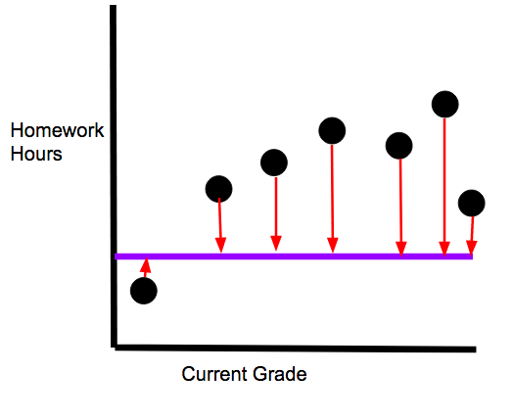
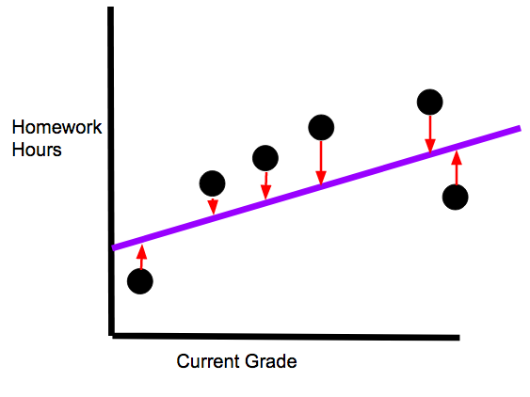
More Loss | Less Loss

Slide 9
 | B | -2.0 | -1.5 | -1.0 | -0.5 | 0.0 | 0.5 | 1.0 | 1.5 | 2.0
W
2.0
1.5 |  |  |  |  |  |  |  |  | 4.05
1.0 |  |  |  |  |  |  |  | 5.32 | 4.33
0.5
0.0 |  |  |  |  |  | 65.6
-0.5
-1.0
-1.5
-2.0 |  | 417
(y = wx + b)
Notes:
Do demonstration

Slide 10
 | B | -2.0 | -1.5 | -1.0 | -0.5 | 0.0 | 0.5 | 1.0 | 1.5 | 2.0
W
2.0 |  | 4.13 | 4.53 | 5.53 | 7.03 | 9.03 | 11.5 | 14.5 | 18.0 | 22.0
1.5 |  | 5.80 | 4.05 | 2.80 | 2.05 | 1.80 | 2.05 | 2.80 | 4.05 | 5.80
1.0 |  | 21.8 | 17.8 | 14.3 | 11.3 | 8.82 | 6.83 | 5.33 | 4.33 | 3.83
0.5 |  | 52.1 | 45.8 | 30.1 | 34.8 | 30.1 | 25.8 | 22.1 | 18.8 | 16.1
0.0 |  | 96.6 | 88.1 | 80.1 | 72.6 | 65.5 | 59.1 | 53.1 | 47.6 | 42.6
-0.5 |  | 155 | 144 | 134 | 124 | 115 | 106 | 98 | 90 | 83
-1.0 |  | 228 | 215 | 202 | 190 | 179 | 168 | 157 | 147 | 138
-1.5 |  | 315 | 300 | 285 | 271 | 257 | 244 | 231 | 219 | 207
-2.0 |  | 417 | 399 | 382 | 366 | 350 | 334 | 319 | 305 | 291
(y = wx + b)
Notes:
Create a contour map

Slide 11
Gif for Gradient Descent
Notes:
Source: https://alykhantejani.github.io/images/gradient_descent_line_graph.gif

Slide 12
Topics Covered Today
Introduction:
Machine Learning Terminology
Learning From Data
Linear Regression:
What is Linear Regression?
Why Linear Regression?
Multivariate Linear Regression
Loss:
Loss Formula
Loss Function
Gradient Descent

